Slide 1


AI-Powered
Flood Severity
Prediction
for Climate Action
By Group 10

Slide 2





IDEA
Predict flood severity in different regions to support early warning systems and disaster management
Use historical flood data, weather, and river basin information to train a machine learning model that forecasts flood severity at regional and country levels.

Slide 3


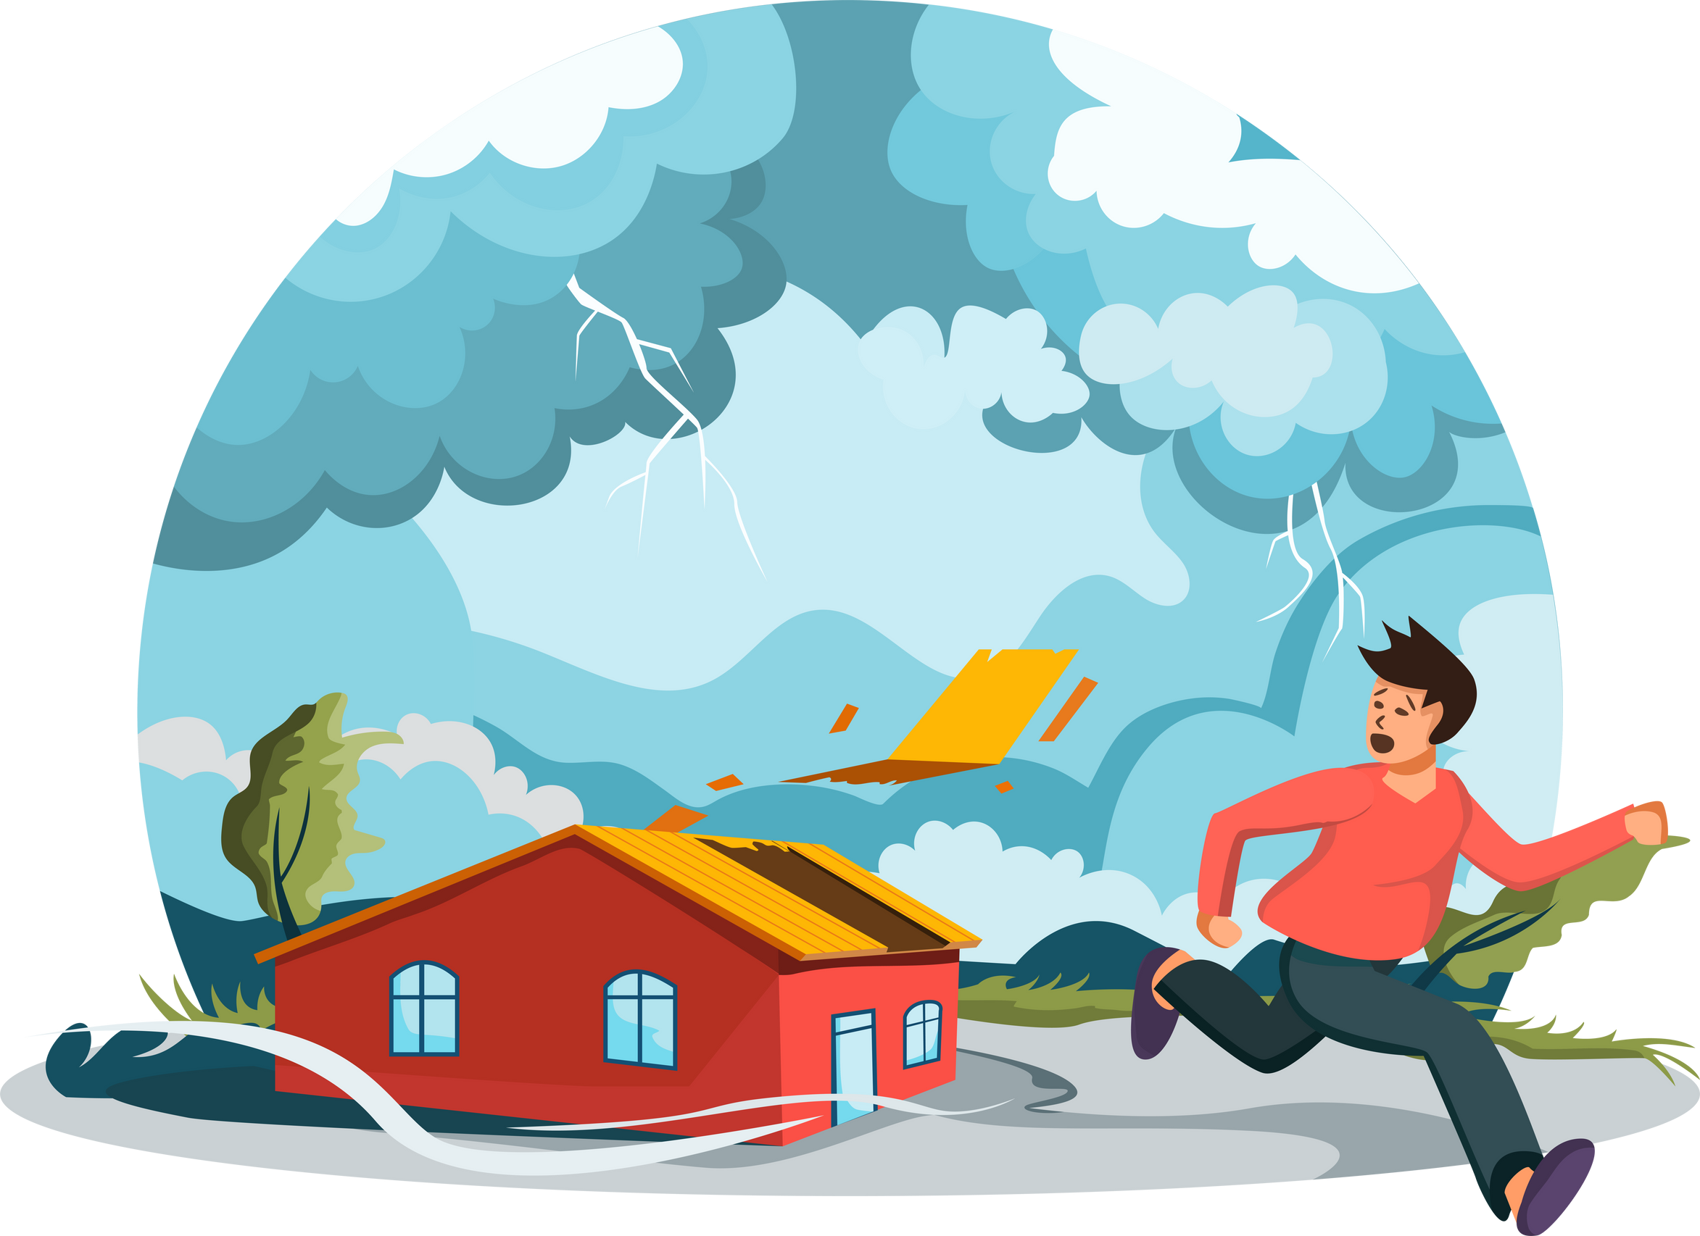

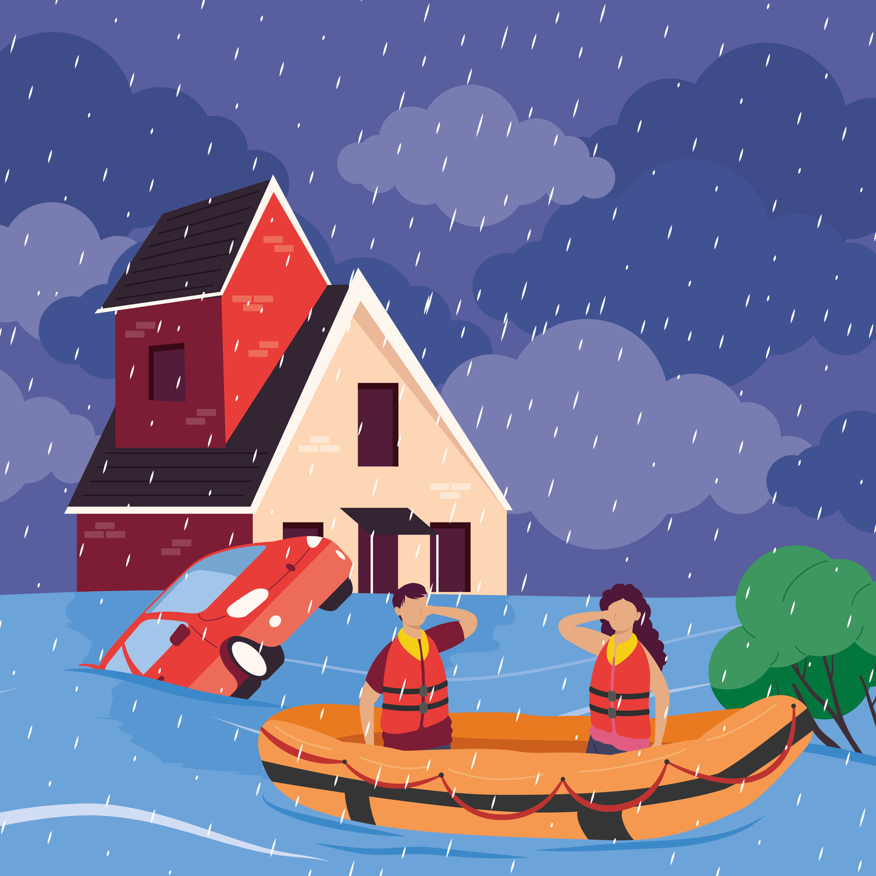
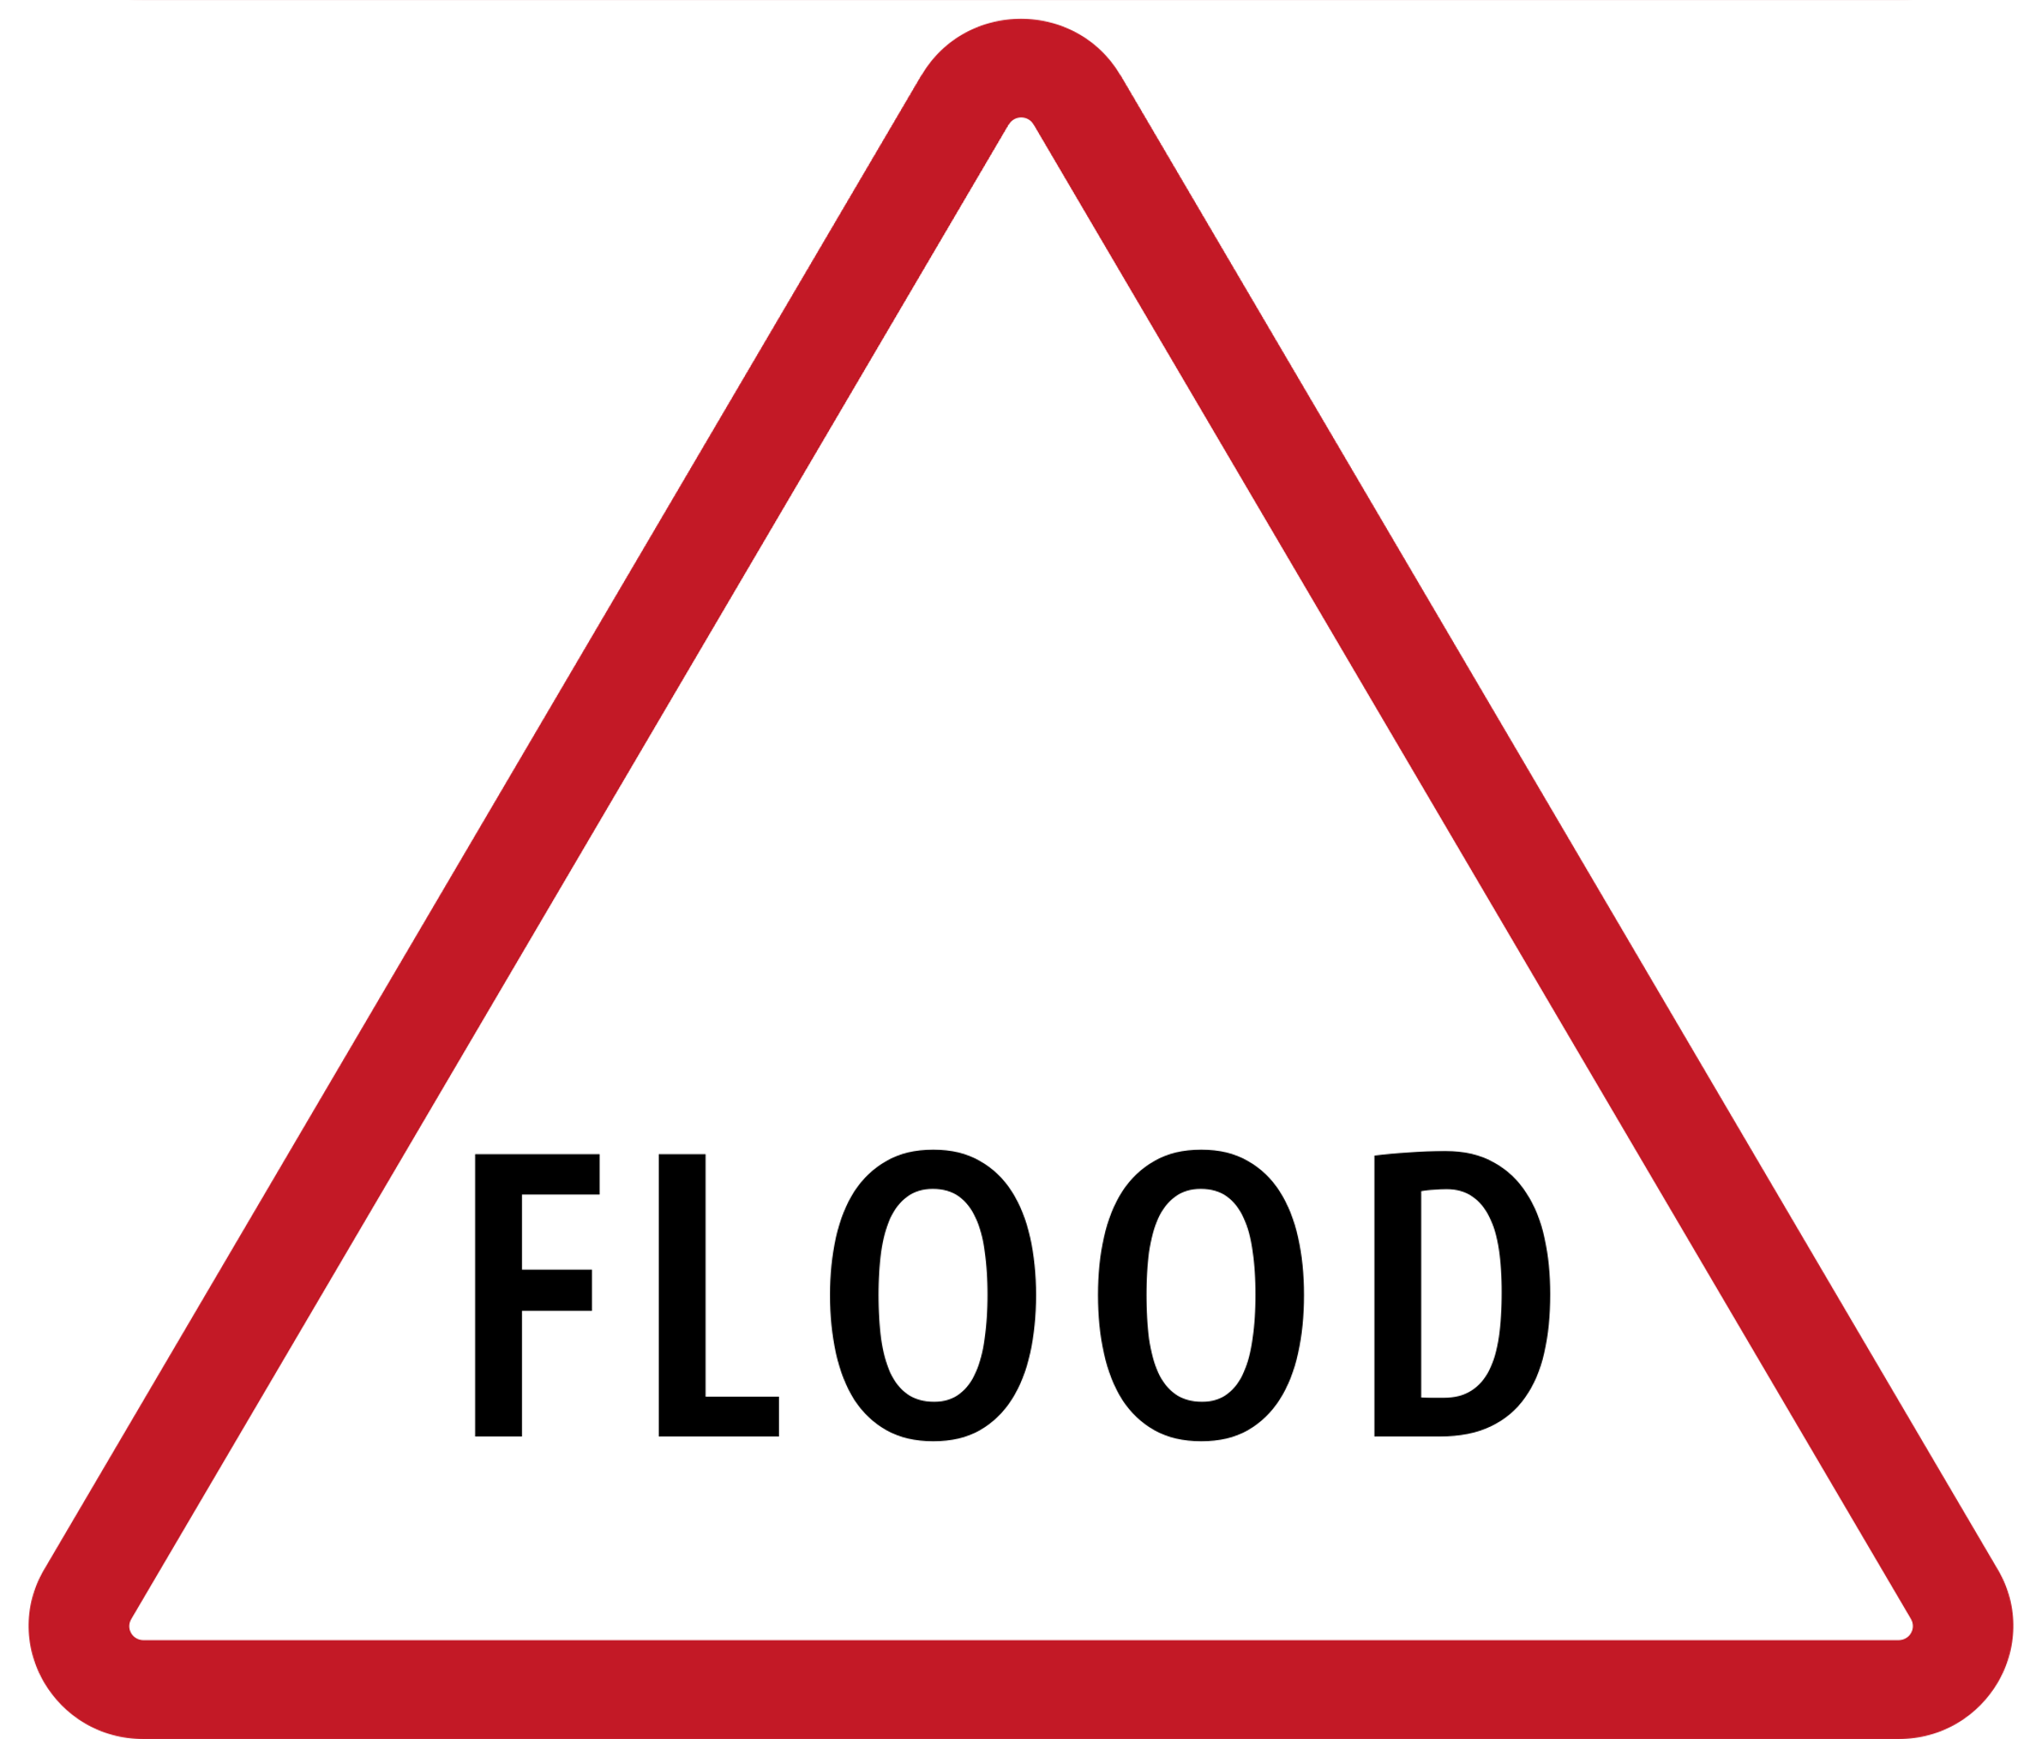

PROBLEM STATEMENT
Increasing frequency of floods due to climate change
Delayed warnings lead to high casualties
Billions in damages every year

Slide 4




THE GOAL
  Predict flood severity in diffHow can we predict and prepare before floods strike?
  SDG 13: Climate Action
  SDG 11: Sustainable Cities & Communities
  Reent regions to support early warning systems and disaster management
  Machine Learning for Flood Prediction
  Inputs: Historical flood data, Climate, Geography
  Output: Predicted severity level

Slide 5





KEY FEATURES
1. Real-time flood severity prediction
2. Feature importance visualization to identify risk factors
3. Country-level heatmaps for predicted severity
4. Alert system for high-risk regions

Slide 6




DATASET
Dataset 1:
Historical flood records (deaths, affected population, damage)
Dataset 2:
Geographic data (latitude, longitude, river basins)
Dataset 3:
Climate data (precipitation, rainfall, seasonal factors)
Dataset 4:
Socioeconomic data (population, infrastructure)
Combine
We combine these four datasets into one.

Slide 7



Roadmap
  Data collection & preprocessing
  Exploratory data analysis
  Feature engineering & encoding
  Train-test split & model training (Random Forest)
  Model evaluation (accuracy, confusion matrix)
  Feature importance & insights
  Visualization (maps, charts)

Slide 8

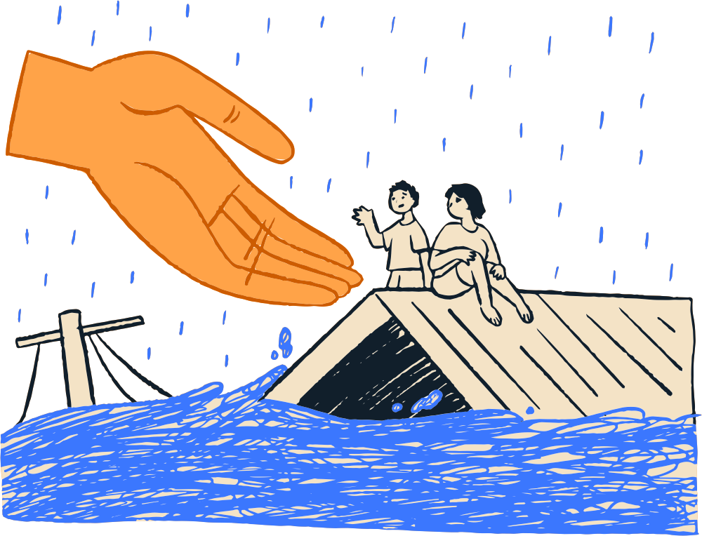

IMPACTS AND BENEFIT
  Early warnings reduce casualties
  Data-driven disaster management
  Efficient allocation of resources

Slide 9

DEMO/ MOCKUP
  Heatmap of predicted severity across regions
  Alerts: High flood risk in Southeast Asia – next 7 days

Slide 10























We cannot prevent floods, but we can prevent disasters.
Thank you

